Slide 1
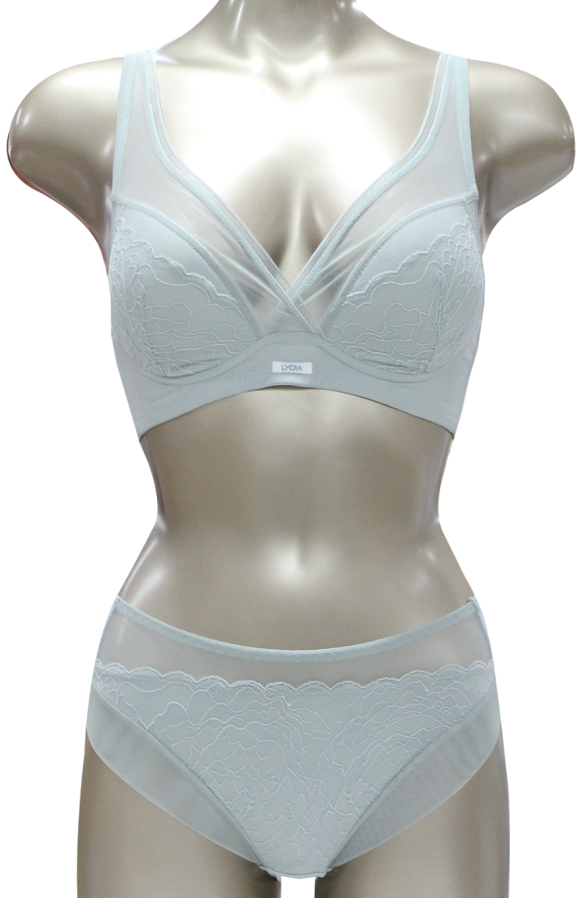
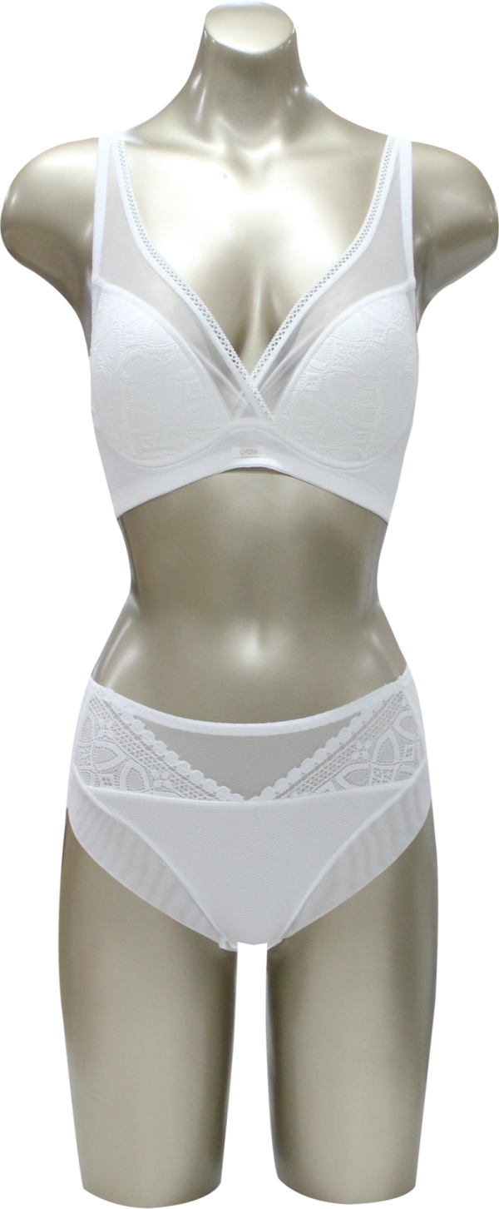
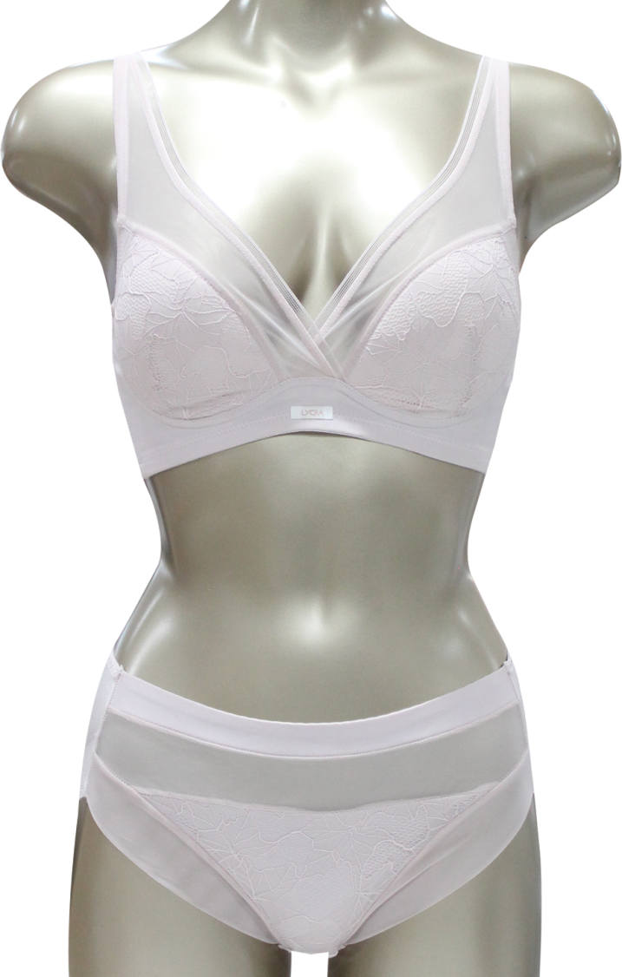
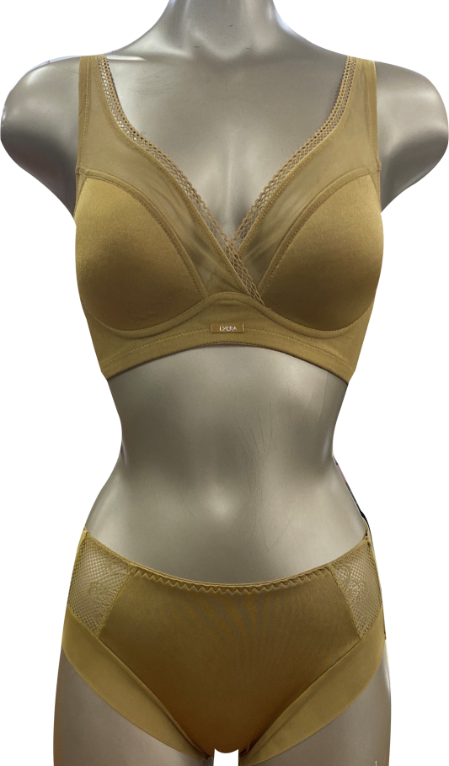
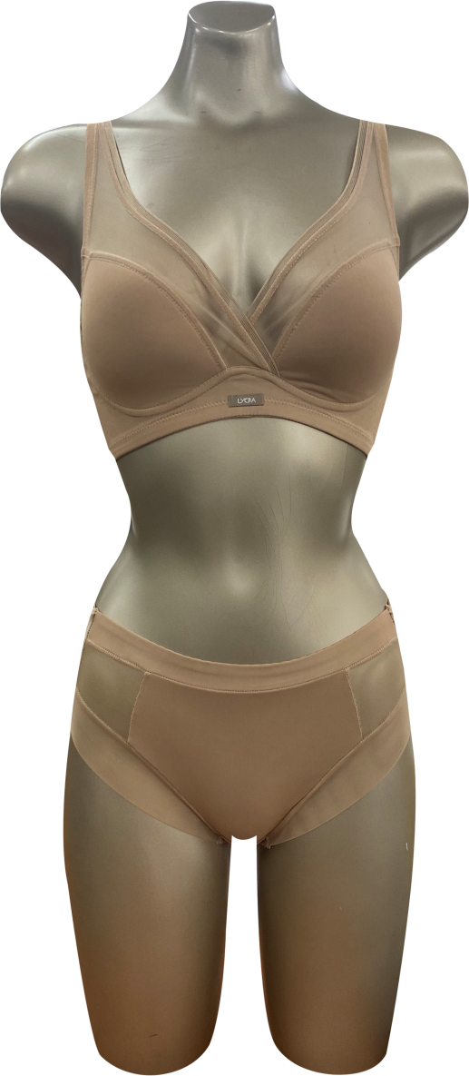
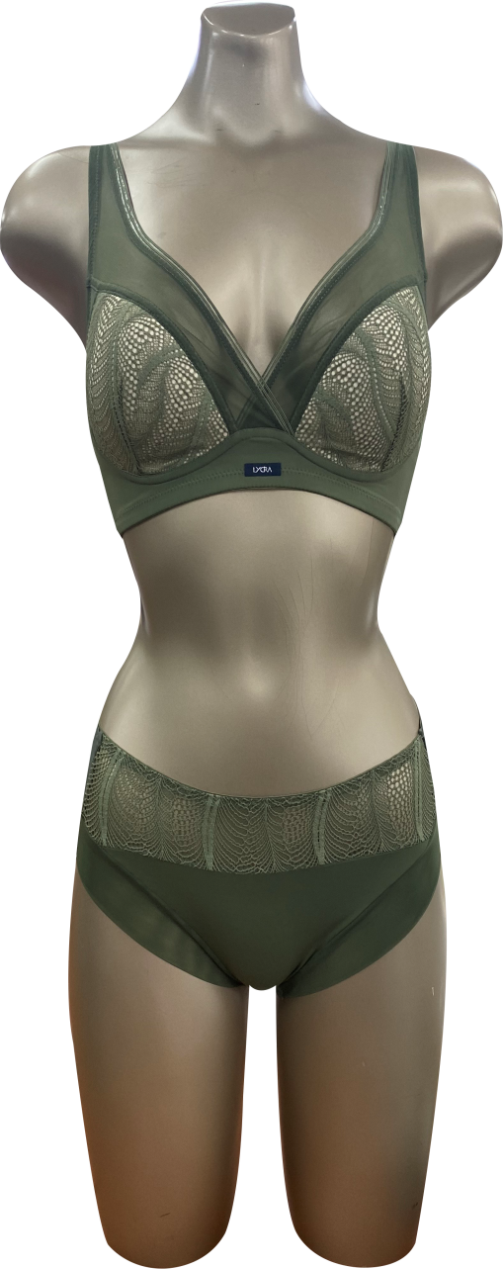
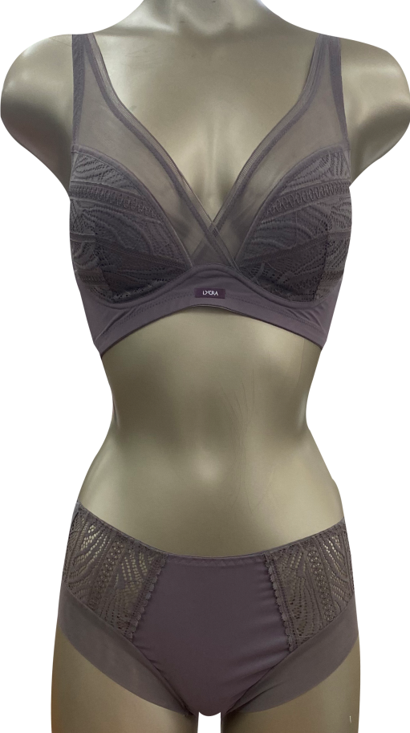
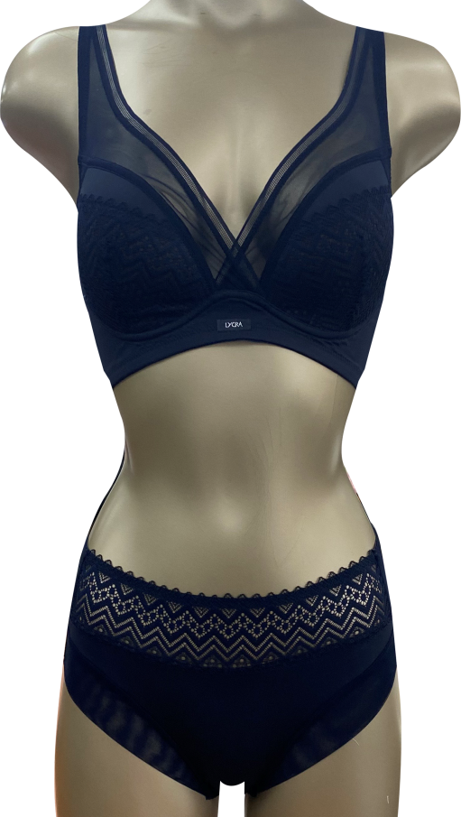
LYCRA beauty <No-wire 76차>
SB/SP 7601 (Blue)
SB/SP 7602 (Ivory)
SB/SP 7603 (Pink)
SB/SP 7604 (Gold)
SB/SP 7605 (Skin)
SB/SP 7606 (Green)
SB/SP 7607 (Brown)
SB/SP 7608 (Navy)

